Slide 1
Java Virtual Threads: A Deeper Dive
Java virtual threads, introduced in JDK 19, are a game-changer for Java developers. This presentation will explore virtual threads and their potential benefits for application performance and memory efficiency.

Slide 2
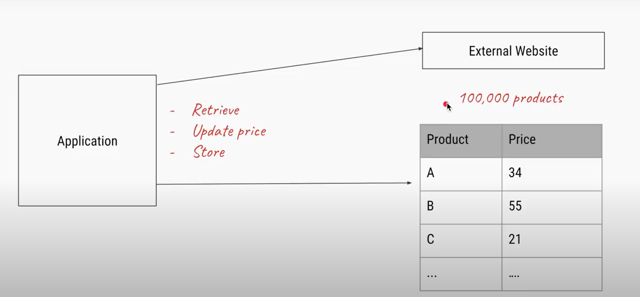
Use Case

Slide 3
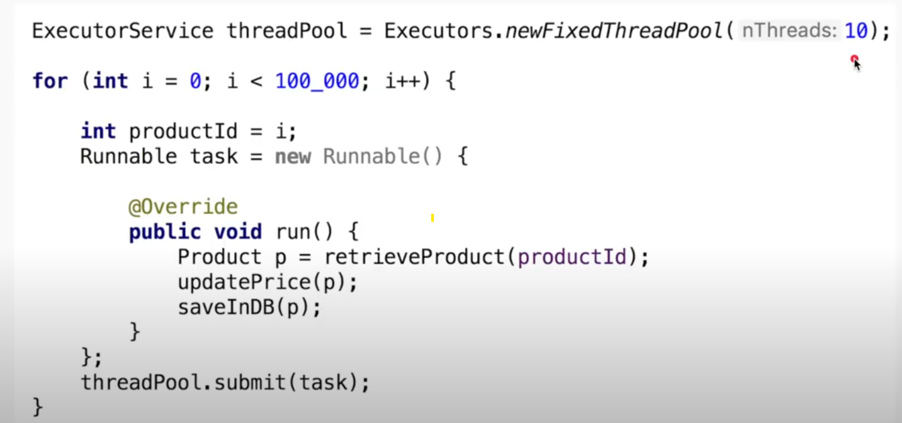
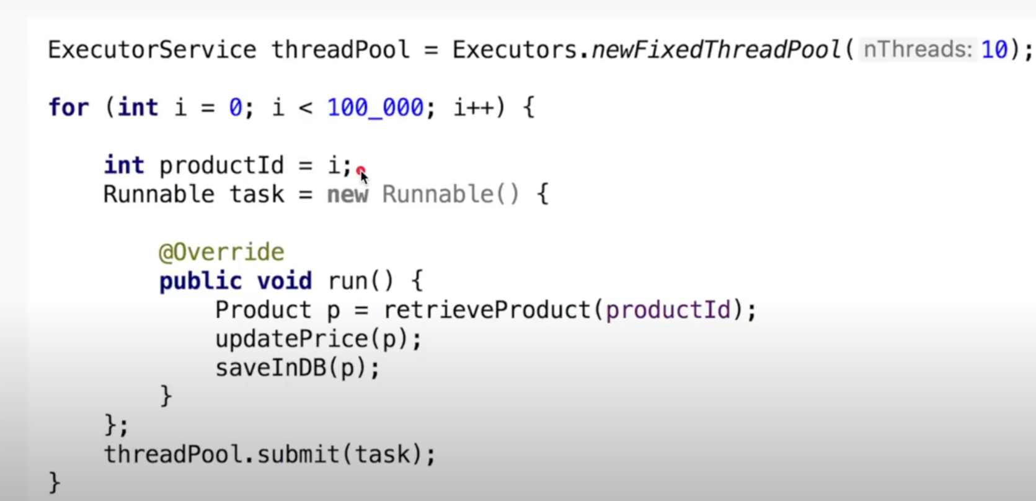
Use Fixed Thread Pool

Slide 4
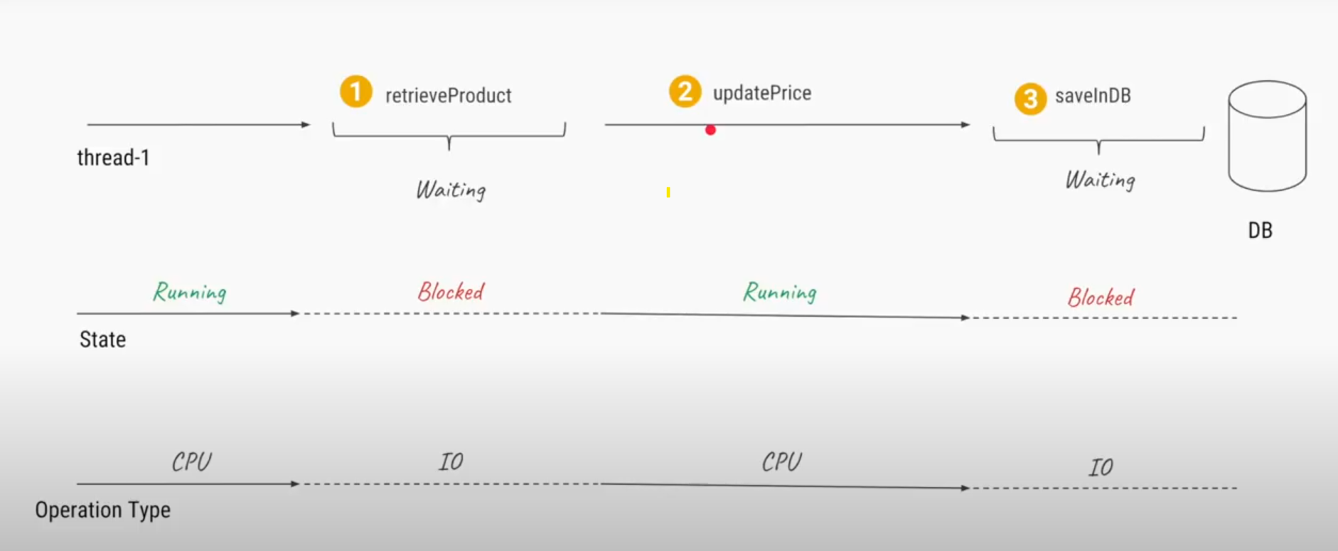
Problem with Fixed Thread Pool

Slide 5
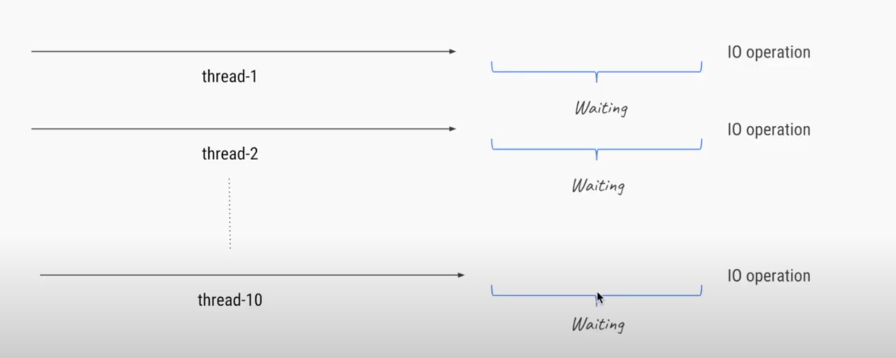
CPU idle time

Slide 6
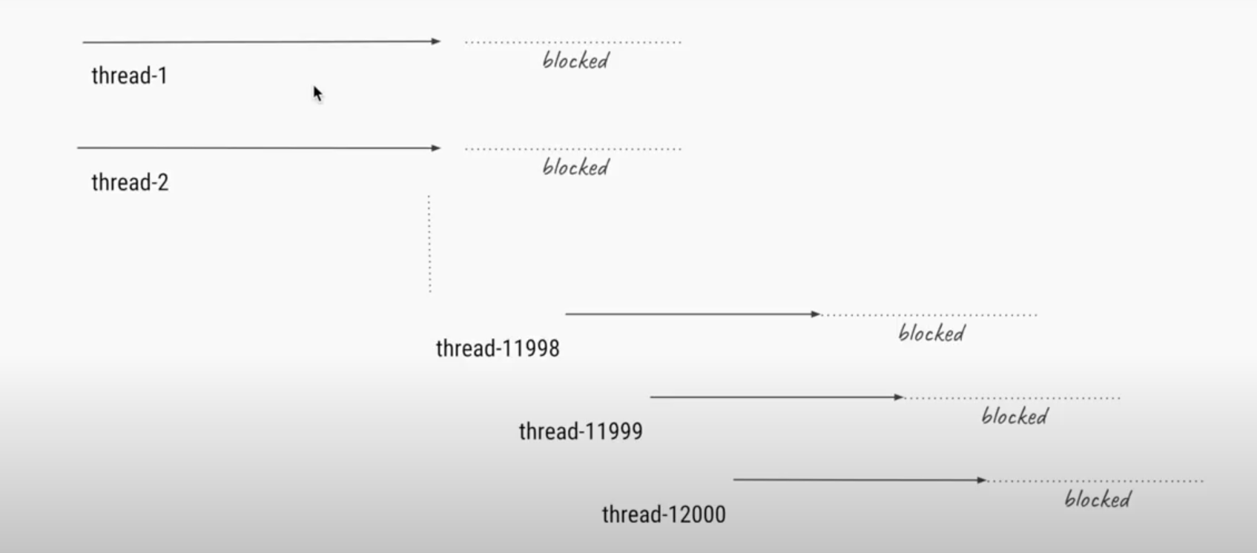
Cached Thread Pool
Cached thread pool can cause out of memory as number of threads created are more.

Slide 7
Core problem
Waiting threads don’t allow scaling (CPU sits idle)
Threads are expensive (1mb stack), can’t create too many.
Tasks waiting for I/O blocks the thread itself.

Slide 8
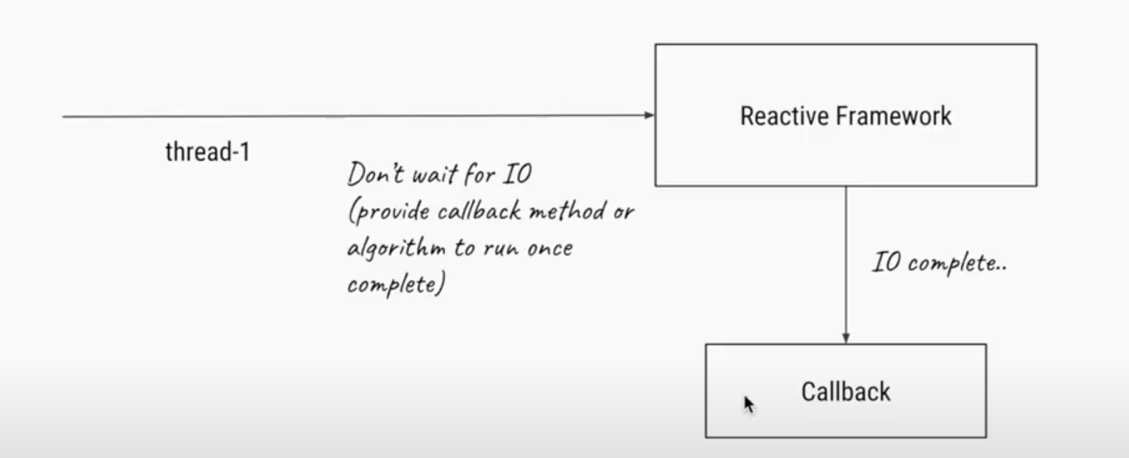
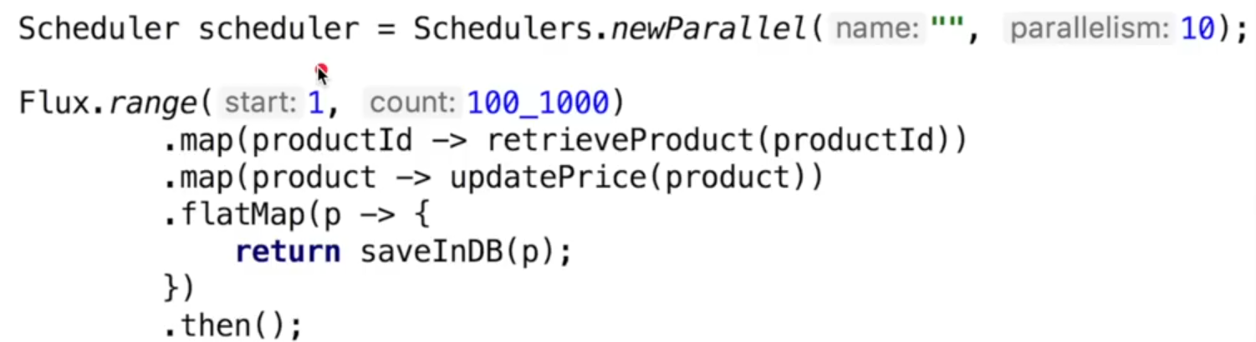
Reactive Programming

Slide 9
Problems with Reactive Programming
Need to learn huge number of APIs to work with it
Not easy to read and understand the code.
Not easy to debug

Slide 10
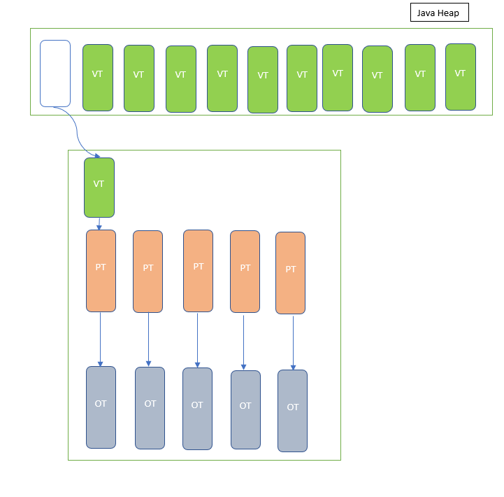
Virtual threads to the rescue
Virtual threads are lightweight, user-mode threads introduced in Java 19 under Project Loom.
Virtual Threads are managed by the Java runtime, decoupled from the OS.
Goal of virtual threads is to simplify concurrent programming by allowing many threads without the overhead of platform threads.
Greatly reduces resource contention, making high-scale concurrency possible.

Slide 11

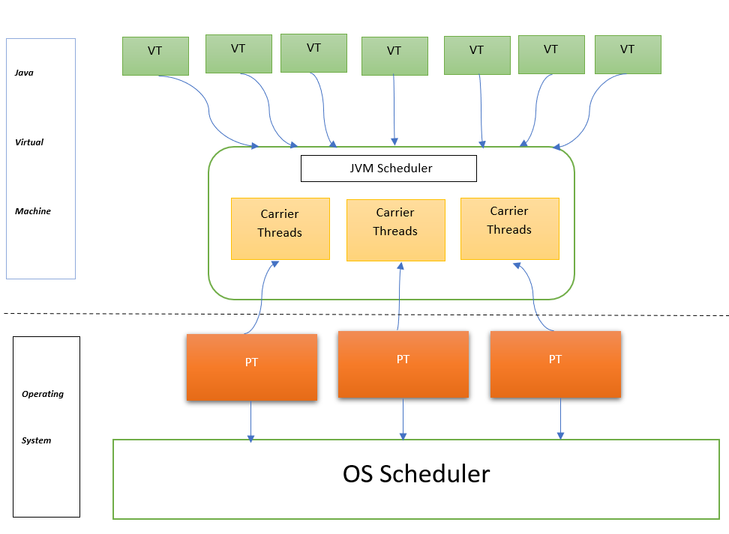
Virtual Threads Architecture
1
Efficient Resource Allocation
Virtual threads are only assigned to platform threads when they need to perform real work.
2
Lightweight and Efficient
Virtual threads reside as objects in the Java heap memory region when not executing real work, making them lightweight and efficient.
3
Carrier Threads
A platform thread acts as a "carrier" for multiple virtual threads, allowing for efficient utilization of OS threads.

Slide 12
Creating Java Virtual Threads
1. Using a static Thread method
2. Using Virtual Thread Builder
//Create a Virtual Builder object with name and initial index
OfVirtual vBuilder = Thread.ofVirtual().name(“userThread”,0)
//Start two virtual threads using the builder
Thread vThread1 = vBuilder.start(VirtualMethodPlays::handleUserRequest())
Thread vThread2 = vBuilder.start(VirtualMethodPlays::handleUserRequest())
//Make sure the thread terminates
vThread1.join()
vThread2.join()
//control reaches here once virtual thread completes
//start virtual thread,no name associated with it.
Thread vThread = Thread.startVirtualThread(()-> handleUserRequests())
//Make sure the thread terminates
vThread.join()
//control reaches here once virtual thread completes
3. Using Virtual Thread Factory
//Create a thread factory
ThreadFactory factory = Thread.ofVirtual().name(“userThread”,0).factory()
//Start two virtual threads using the factory
Thread vThread1 = factory.newThread(VirtualMethodsPlay::handleUserRequest())
vThread.start()
//Make sure the thread terminates
vThread1.join()
//control reaches here once virtual thread completes
4. Using Virtual Thread Executor Service
//Create a thread factory with custom name
ThreadFactory factory = Thread.ofVirtual().name(“userThread”,0).factory()
//Create a Virtual thread executor service
//Note the try-with-resources make sure all virtual threads terminated
try(ExecutorService srv = Executors.newVirtualThreadPerTaskExecutor(factory)){
//submit two tasks to executor service
srv.submit(VirtualMethodPlays::handleUserRequest())
}
//control reaches here once virtual thread completes

Slide 13
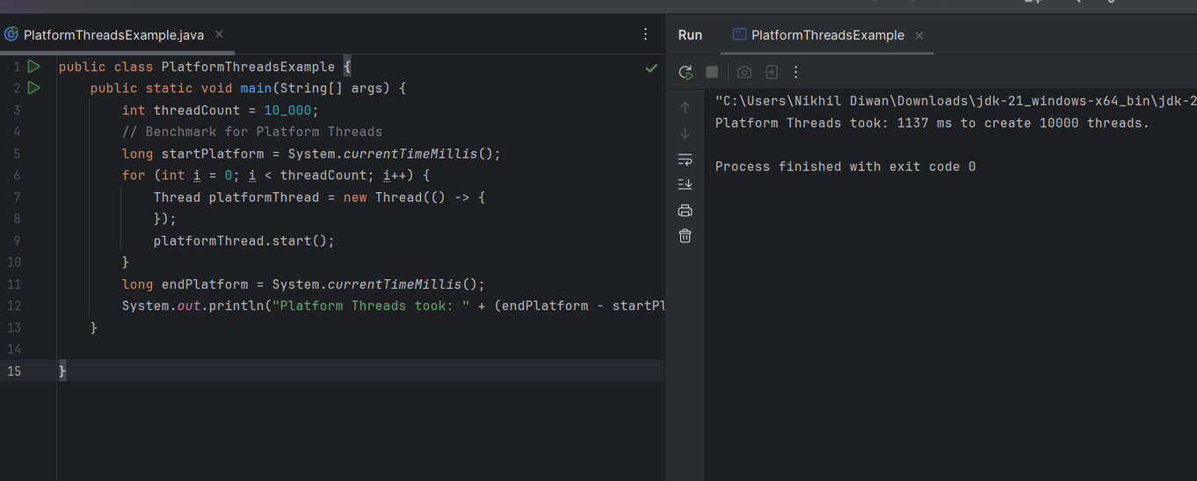
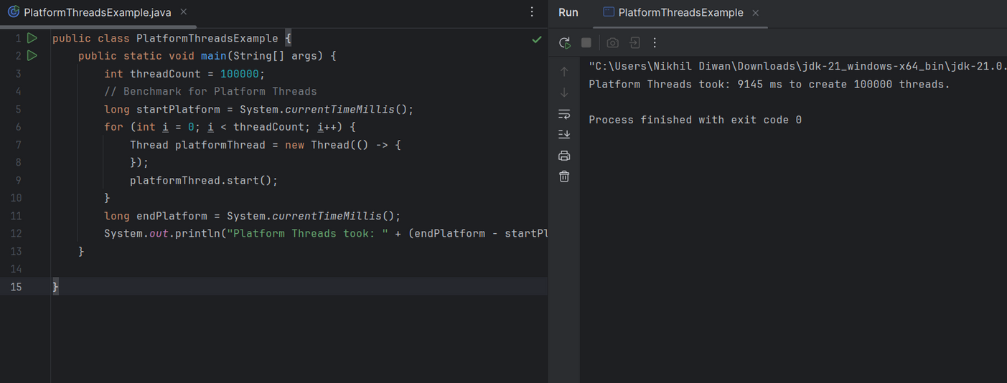
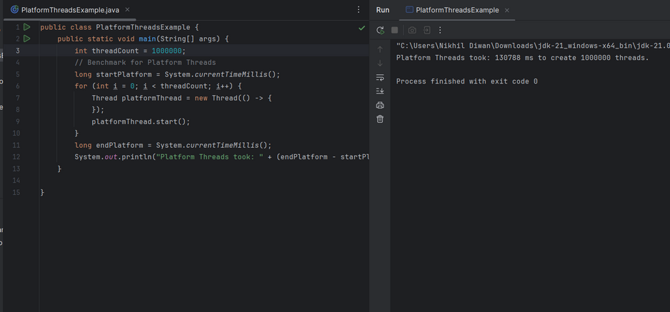
Platform Threads – Thread Creation Timings
.
Platform Thread took 1137 ms for creation of 10k threads.
Platform Thread took 9145 ms for creation of 0.1 million threads.
Platform Thread took 130788 ms for creation of 1 million threads.

Slide 14
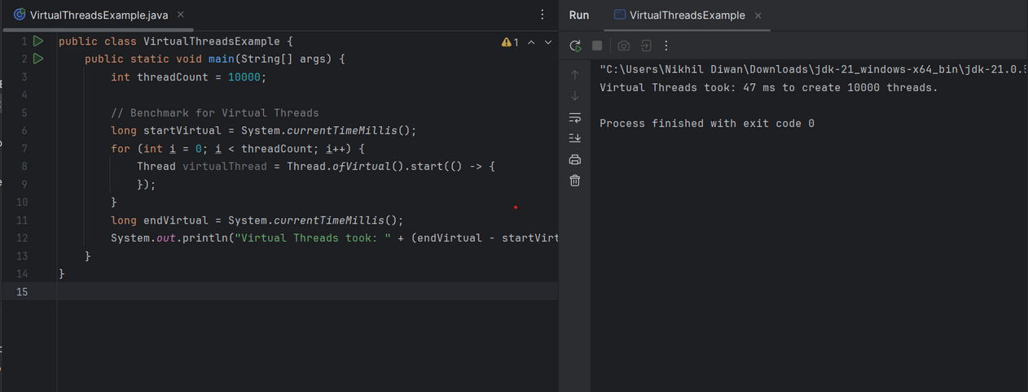
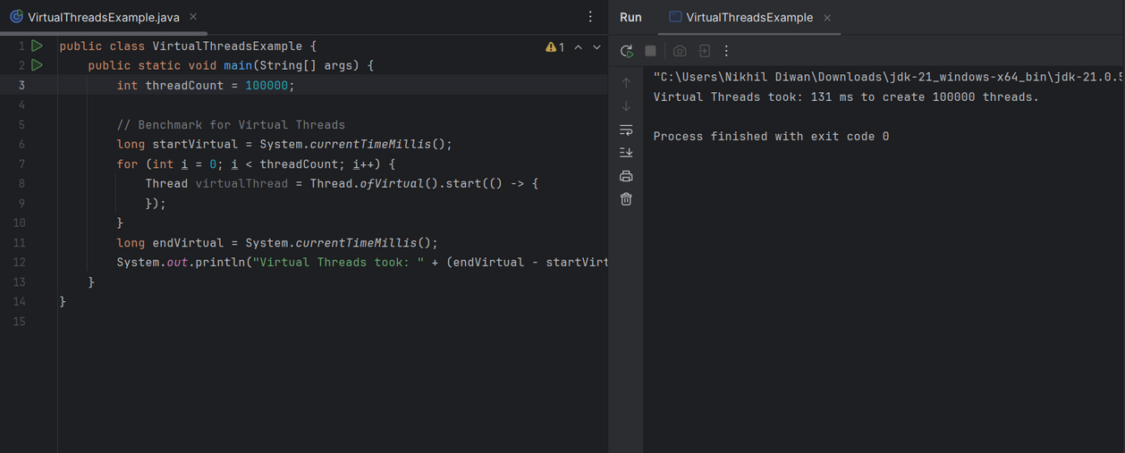
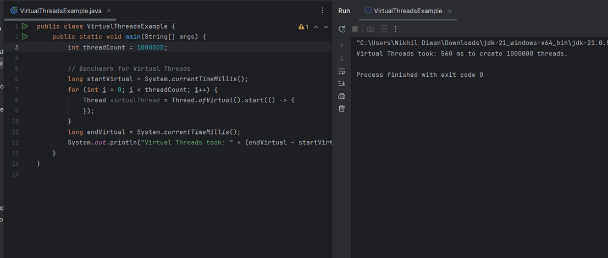
Virtual Threads – Thread Creation Timings
.
Virtual Thread took 47 ms for creation of 10k threads.
Virtual Thread took 131 ms for creation of 0.1 million threads.
Virtual Thread took 560 ms for creation of 1 million threads.

Slide 15
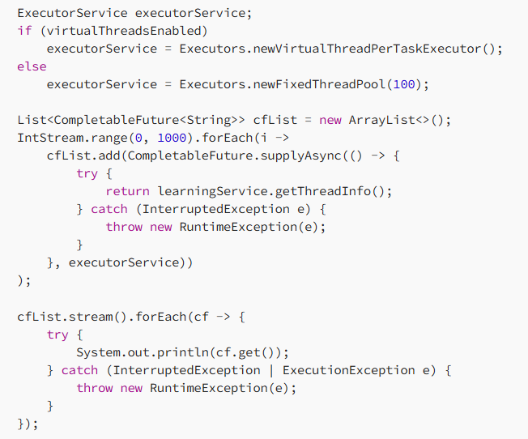
Completable Feature with virtual threads
A CompletableFuture represents a future result of an asynchronous computation.
It allows us to chain computations in a non-blocking manner using methods like .thenApply(), .thenCompose(), and .thenAccept().
The following example uses CompletableFuture to call a service multiple times in a loop in asynchronous fashion.
The CompletableFuture uses the executor created threads to call the LearningService method asynchronously 1000 times. After the asynchronous calls are complete, the values are obtained from the CompletableFutures.

Slide 16
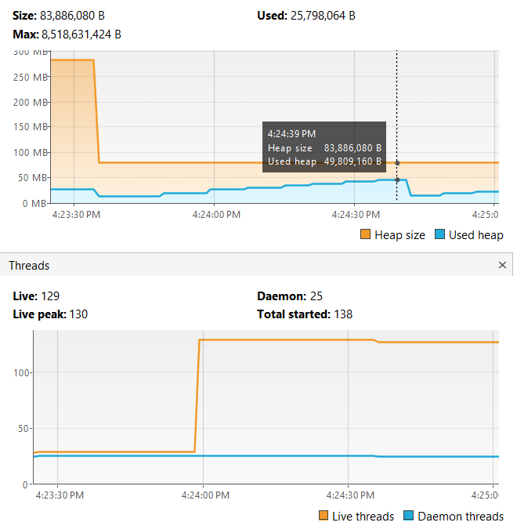
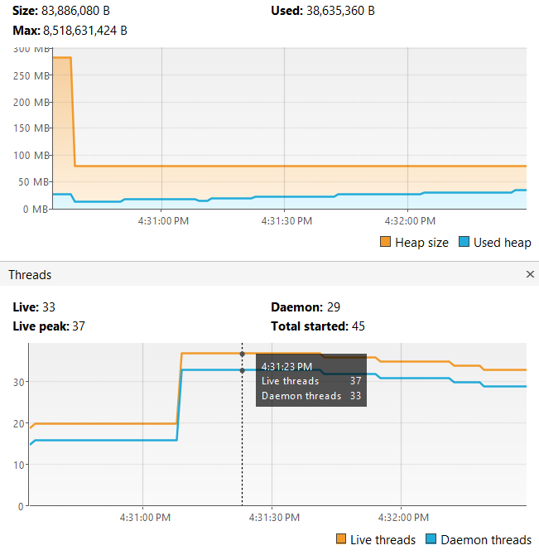
Performance comparison using completable future
Platform Threads
It uses the Executor service fixed thread pool of 100 threads to perform the asynchronous processing. It runs for 20 secs to call the service 1000 times using 100 threads from the threadpool and around 50 MB of memory
Virtual Thread
It runs for 2 secs to call the service 1000 times using 37 threads and around 21 MB of memory
The above comparison shows that CompletableFuture is able to use virtual threads and handle asynchronous processing in a very efficient manner.

Slide 17
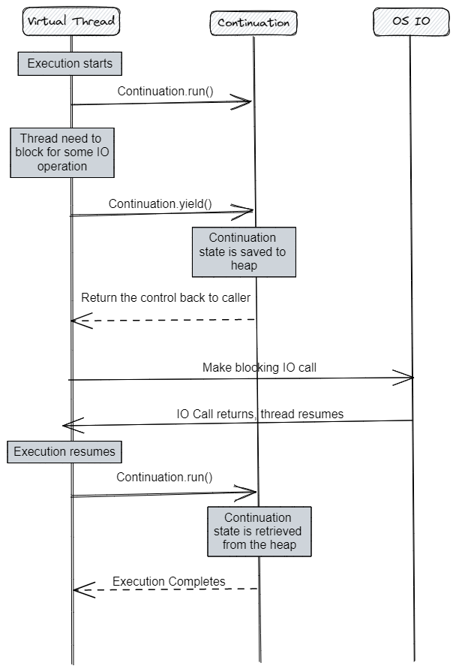
Continuation API
Continuation is a programming technique that allows a program to pause its execution at a specific point and later resume execution from where it left off
Continuation API is part of the Coroutine Framework
Continuation API provides a way for a program to capture its current state, including its call stack and local variables, and later restore that state to resume execution.
Continuations are useful for implementing cooperative multitasking
When a virtual thread is created, it is associated with a Continuation object that captures its current state.
The virtual thread can then perform some computation or I/O operation, and if it needs to be suspended, its Continuation object is saved to the heap, and its state is restored to a previous point in time.
When the I/O operation completes, the virtual thread can resume execution from where it left off by restoring its Continuation object from the heap and returning to the suspension point.

Slide 18
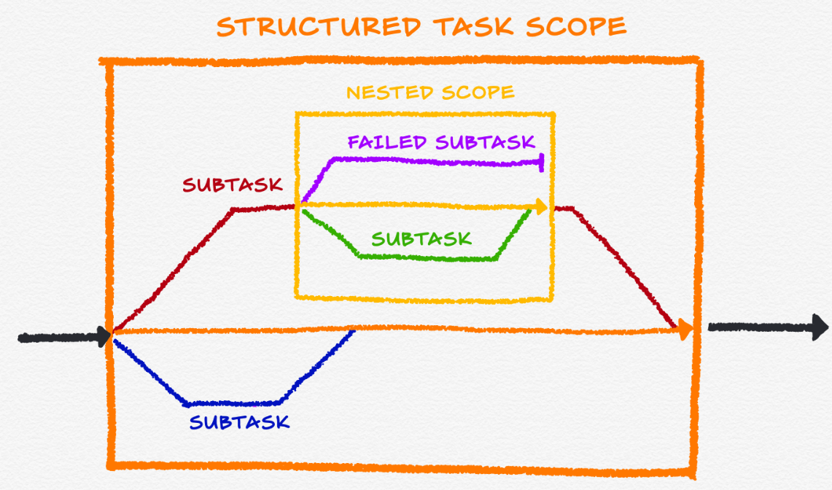
Structured Concurrency
Structured concurrency is the idea of organizing concurrent tasks in a well-defined scope.
It is an approach to maintain the inherited scope of subtasks related to a parent task by ensuring every child subtask returns to the same place when they finish. This achieves better reliability and observability.
Parent-child relationship between tasks.
Ensure tasks complete or fail within a controlled structure.
Resource cleanup and error handling becomes easier.
The StructuredConcurrency API is responsible for the cancellation instead of leaving it to the developer(s) or framework.
Every incomplete thread shuts down when the scope completes (or fails).
There are currently two scopes available:
ShutdownOnSuccess: shuts down all threads after one succeeds or fails. This is appropriate when only the result of the first successful request is enough.
ShutdownOnFailure: shuts down all threads after one fails. This is appropriate when all requests must be successful.

Slide 19
Pinned Threads
In virtual threading, pinning occurs when a virtual thread becomes stuck to its carrier thread, preventing it from being preempted
A virtual thread cannot be unmounted during blocking operations when it is pinned to its carrier.
A virtual thread is pinned in the following situations:
Native System Calls: Operations like file I/O, certain types of network I/O, or native libraries may cause a virtual thread to pin to an OS thread.
Synchronized Blocks: When a virtual thread enters a synchronized block, it temporarily gets pinned to a specific OS thread to maintain proper synchronization semantics.
3. Impact of Pinning:
Reduced Concurrency: While pinned, a virtual thread is backed by an OS thread, reducing the benefit of lightweight virtual threads.
Blocking OS Threads: If many virtual threads are pinned, they can block OS threads, limiting scalability.
Temporary: Pinning is only for the duration of the operation that requires it, after which the virtual thread becomes lightweight again.
4. Mitigating Pinning:
Avoid Overuse of synchronized Blocks: Use higher-level concurrency constructs like ReentrantLock or other thread-safe collections to reduce pinning.
Use Non-Blocking I/O: Opt for non-blocking I/O operations to avoid pinning during native calls.

Slide 20
Platform vs Virtual Threads
Aspect
Platform Threads
Virtual Threads
Definition
OS-managed threads, also known as kernel or system threads.
Lightweight user-mode threads, managed by the JVM.
Resource Consumption
Each platform thread consumes significant system resources, including OS-managed memory (stack) and CPU time.
Virtual threads are more memory-efficient, as the JVM manages the stack, and they are scheduled within JVM rather than the OS.
Creation Overhead
Expensive to create due to OS involvement.
Very low overhead for creation, allowing for millions of threads to be launched simultaneously.
Scheduling
Handled by the OS scheduler.
Handled by the JVM’s internal scheduler, more flexible and scalable.
Blocking I/O
A platform thread blocked by I/O operations ties up an OS thread, reducing overall concurrency.
Virtual threads yield control when blocked, allowing the JVM to continue executing other tasks without blocking an OS thread.
Concurrency Scalability
Limited by the number of CPU cores and system resources.
Designed for high scalability, supporting millions of threads even on systems with few cores.
Performance in I/O-bound Tasks
Inefficient due to blocking, leading to thread starvation under heavy load.
Efficient with I/O-bound tasks because virtual threads can pause and let others execute, avoiding OS-level blocking.
Memory Usage
High memory consumption per thread (approx. 1 MB per thread due to the OS stack).
Low memory footprint (approx. tens of KB per thread, depending on the JVM).
Thread Stack
Stack memory is pre-allocated by the OS and grows in large increments, which can lead to waste.
Stack is dynamically allocated and grows on-demand, reducing waste.
Use Case
Ideal for CPU-bound, multithreaded tasks, such as parallel computations and tasks that require direct OS-level threading support.
Ideal for highly concurrent, I/O-bound tasks like web servers, microservices, and applications with many lightweight tasks.
Compatibility
Works across all existing systems and libraries that rely on OS threading models.
Requires support from the JVM (introduced in Java 19), and some legacy libraries may need adaptation to fully leverage virtual threads.
Context Switching
Involves expensive OS-level context switching.
Context switching between virtual threads is managed by the JVM and is more efficient than OS-level switches.
Debugging and Profiling
Mature tools and techniques available due to long-standing support for platform threads.
Less mature, though improving rapidly with newer tools that support virtual thread-specific debugging.
Garbage Collection Impact
Platform threads have minimal impact on GC since they operate outside of JVM memory.
Virtual threads could impact GC more as their stacks are managed within JVM memory.

Slide 21




Advantages of Java Virtual Threads
Improved Availability
Increased Throughput
Applications can handle more concurrent requests with fewer resources.
Applications can process requests faster, leading to improved performance.
Reduced Memory Consumption
Improved Code Quality
Virtual threads are lightweight, reducing overall memory usage.
Virtual threads simplify code and enable more concise programming.

